Slide 1

HEALTHY LEAVES

Slide 2
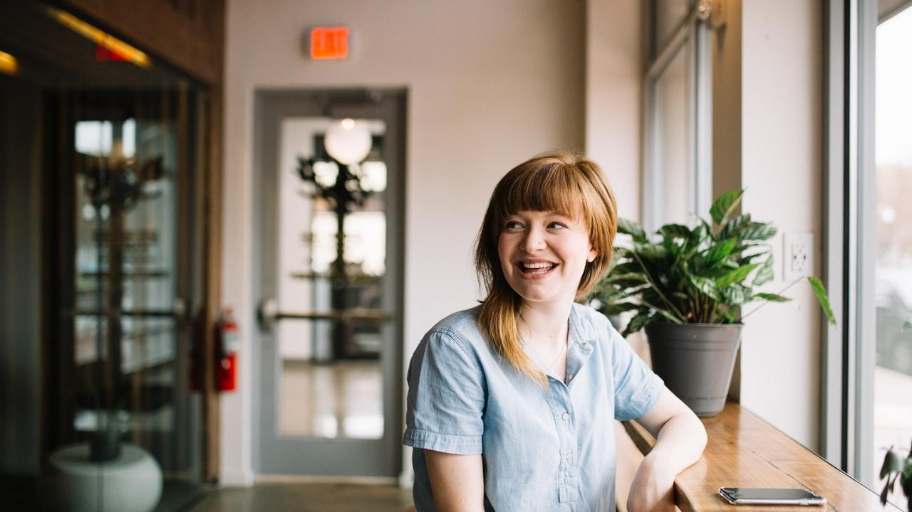
Hello
We are the HealthyBoiis COOP and we love plants, science and technology!

Slide 3

“Emotional relationship. They help cope with hardships, and allow us to grow in physical and human relationships.”

Slide 4
“I look at them and they make me happy. They brighten my day.”

Slide 5
“If I see one plant die, I feel like I’ve let it down. I begin to guilt myself.”

Slide 6

Our Customers
Let’s identify our customers.

Slide 7

Customer Profile
Interview approach:
Demographics
Reasons
Problems

Slide 8
Owners
Independent of:
Gender
Age
Social class

Slide 9
Reasons
Used for:
Emotional support
Aesthetics
Food growth

Slide 10
Problems
Biggest cons:
Over- or under-watering
Sudden wilting
Unidentifiable illnesses

Slide 11

Healthy
Leaves
The device that solves problems and allows users to be in touch with their plant friends.

Slide 12
Why us?
Let’s identify the value of the product.

Slide 13
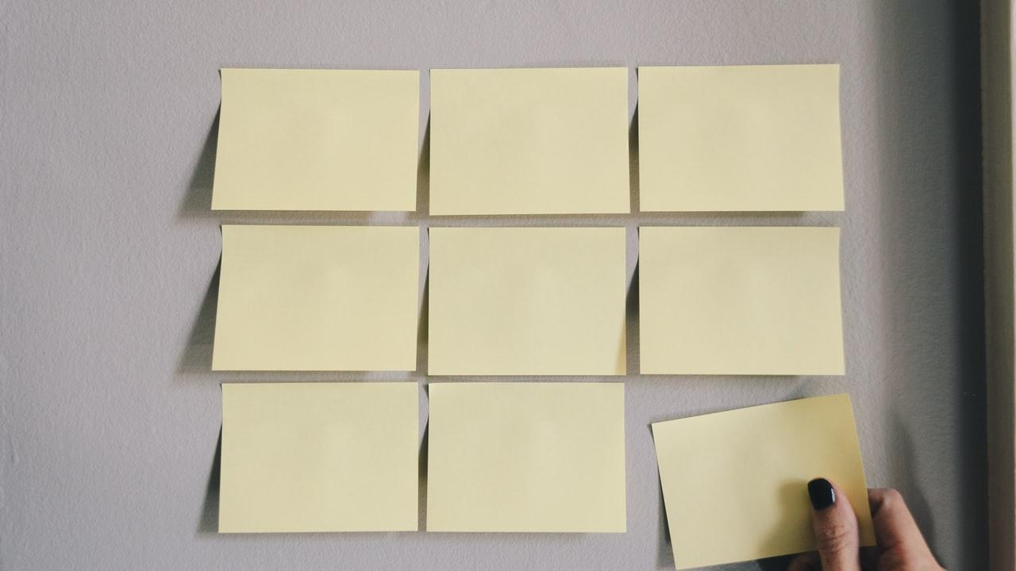
What’s Important
Our product is:
Humane
Aesthetic
Quality made

Slide 14
Humane
We give users the ability to:
Communicate
Health check
Interact

Slide 15
Minimalist
Product is aesthetic because it is:
Discrete
Minimalist
Wireless and noiseless

Slide 16
Quality
Our product is rugged:
Simple
Weather resistant
Continuously improved

Slide 17
Functionality
Let’s see how it all works.

Slide 18

Functional Overview
App
User interface. Informs user on plant well-being in terms of real-time data read from the database.
Database
Main information storage. Has user and plant IDs, predefined data for plants and real-time data for users.
Device
Information collector and processor. Sends processed data to database, can be recharged.

Slide 19
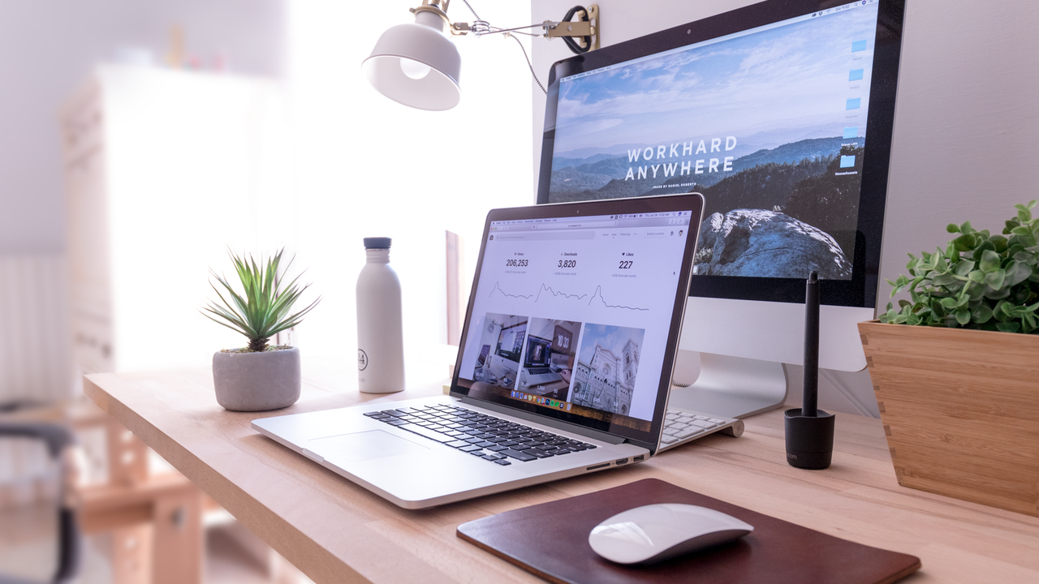
Design
Our plan:
UX Design
Hardware
Future

Slide 20


Slide 21
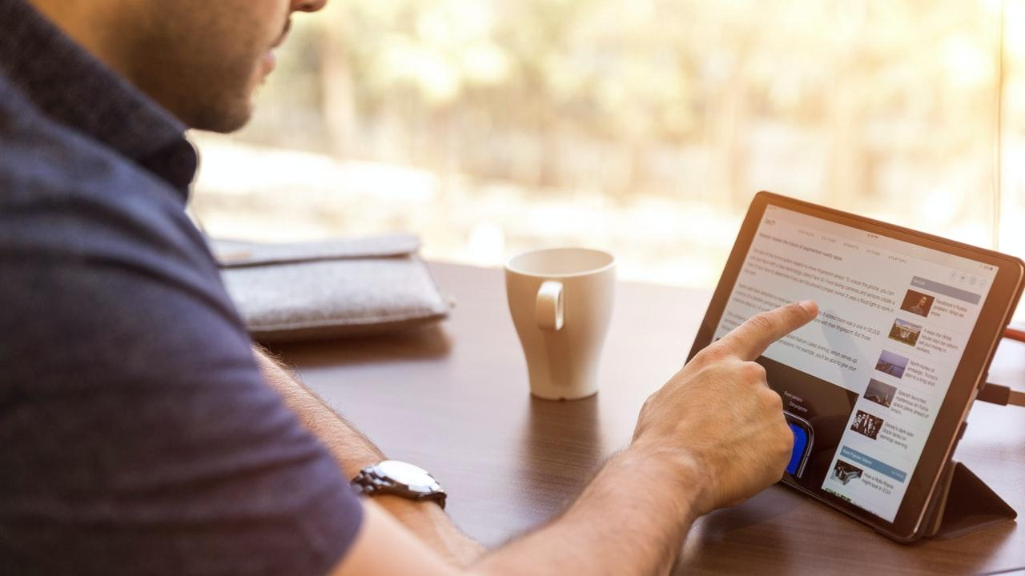
UX Features
User Account
User Interface
Real Time Data
Plant Catalog
Notifications
Data Analytics
Advising
Plant Ident.

Slide 22
User Account
Features:
Login and Signup
Cloud stored accounts
Individual user plants stored
Pairing Protocol
Notes:
THOMAS:
The first feature that enhances the user experience is our application’s ability to provide individual accounts to our users.
These accounts are stored on a cloud service provided by Firebase, which means the emails and passwords are stored securely by google and can be accessed at any time because Firebase servers are running 24/7.
Therefore, from these proper individual accounts, users can also store unique user plants to their user account.
Finally users can also pair their microcontroller (on the plant sensors side) with the unique plants they created on the application using our pairing protocol.
The pairing can be done two ways:
On the hardware box our product gets shipped in, a given device ID is given and the user can enter it to pair their plant with the device.
Otherwise, for an extra fee, the pairing can also be done on the provider side, pairing the user’s plant to the device without the user doing anything, which makes this a very user friendly product.

Slide 23
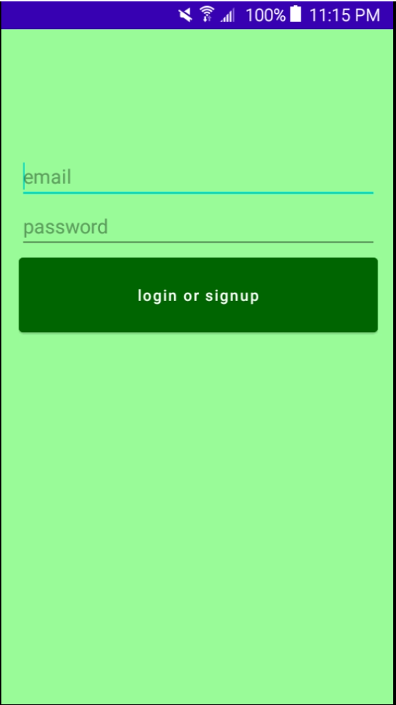
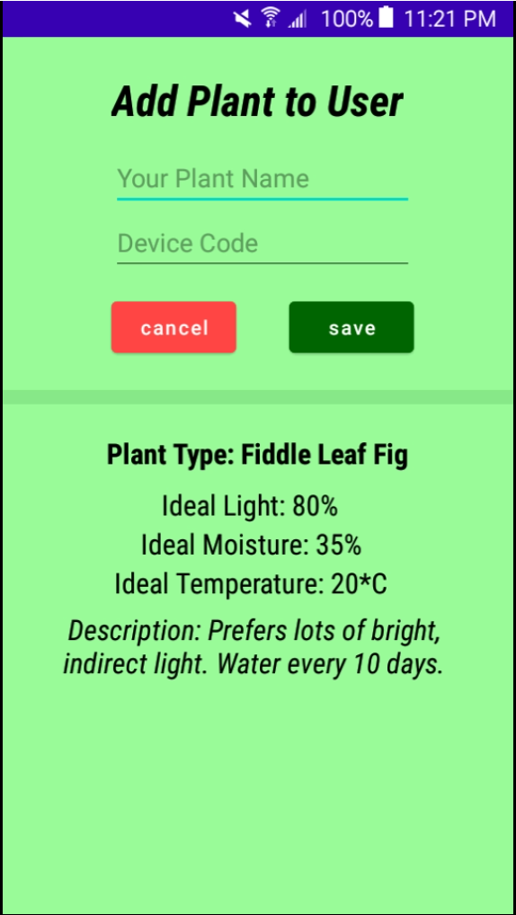
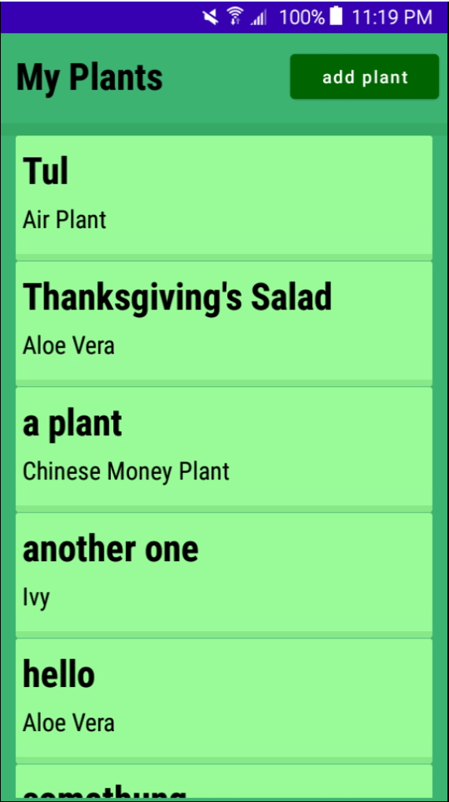
Notes:
THOMAS:

Slide 24
User Interface
Features:
Minimalistic design
Color palette
Text style
Notes:
THOMAS:
Our application’s user experience is also enhanced by the applications minimalistic design, as in it’s coherence and uniformity in the color palettes and text styles.
The main color palettes come from green and its complementary colors and all text buttons are in lower case to give the effect of space in the application.
These user interface details add up to make a very user friendly application, with easy navigation and good looking UI.

Slide 25
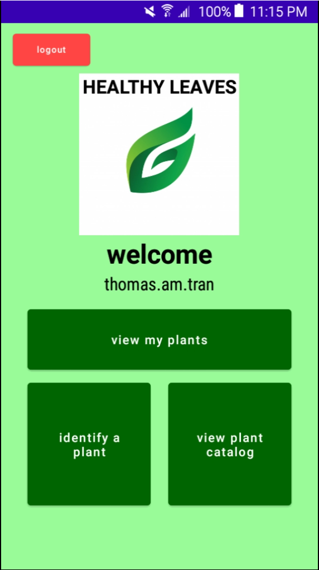
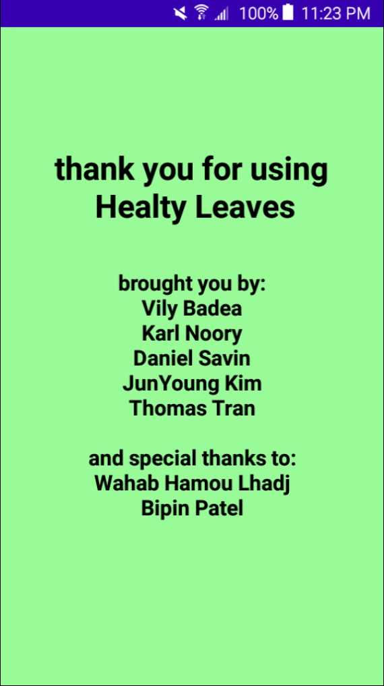
Notes:
THOMAS:
Here you can appreciate how beautiful our minimalistic home page looks with our Healthy Leaves logo and a warm welcome message to the user.

Slide 26
Real Time Data
Features:
Data updated live
Experimental modifications
Read on any device
Scalable product
Notes:
THOMAS:
All of the data that is getting measured on the microcontroller side and the application side for any unique plant is equipped with real time data.
This means that the measured data can be seen changing LIVE when the data is getting displayed on the application.
This also holds true for data shown in our graphs and log tables, so that the user can see the evolution of the data points.
Plus, because the user has access to real-time data, he or she can use this feature to experiment with the value levels such as watering the plant and seeing the water percentage level approaching the ideal values.
The real time data is stored on a cloud service which means that it can be read from ANY android device! You would just need to know the credentials of the user that owns the unique plant.
And our product is therefore scalable because all users, unique plants, plant types, data entries… are created dynamically.

Slide 27
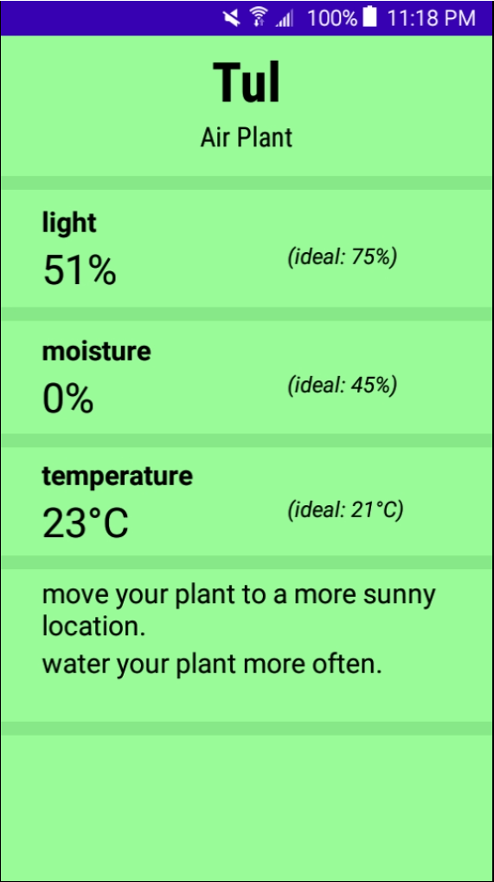
Notes:
THOMAS:

Slide 28
Plant Catalog
Features:
“Wikipedia” of plants
Fueled by the users
Editable
Notes:
THOMAS:
In our product’s application, the users can access a public forum where anyone can add new plant types, edit them, and choose any of them to associate to the plant they own.
This works in the same idea as wikipedia, but here it’s a wikipedia of plants, a encyclopedia/catalog of all the plants and their ideal values to maximize their healthiness.
We filled out the catalog with a plethora of plants and their ideal values that we researched ourselves, but in terms we see this catalog being fueled by the users themselves as we create a Healthy Leaves community of Plant and Data lovers.

Slide 29
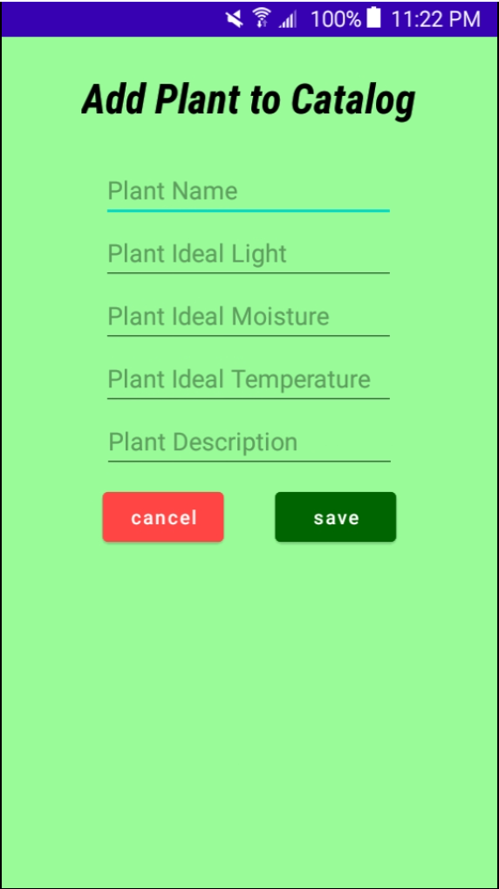
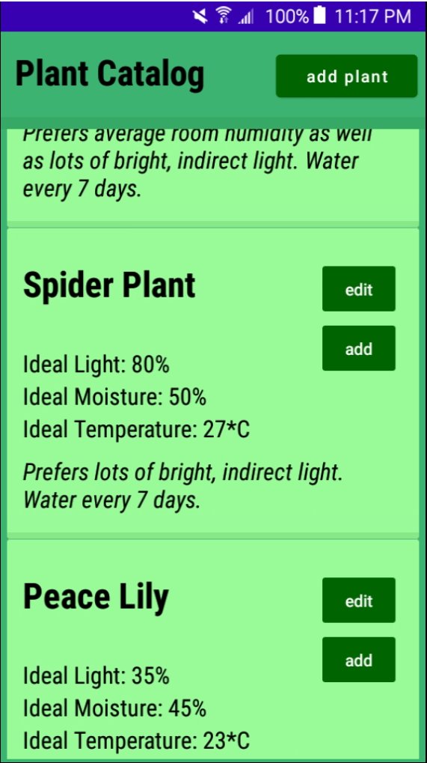
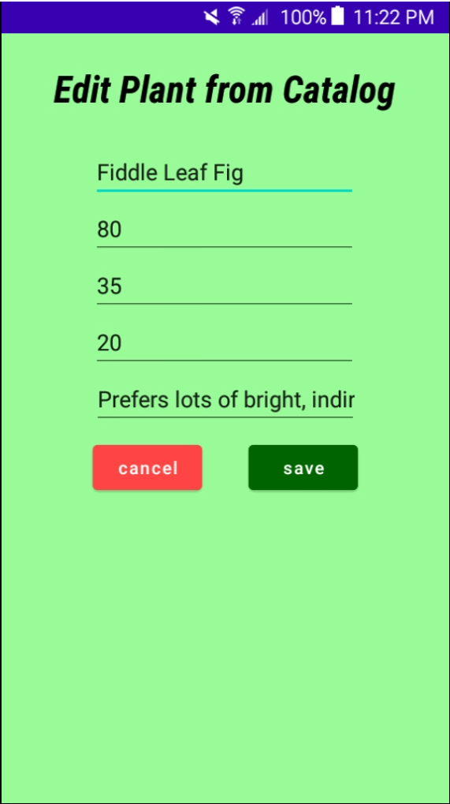
Notes:
THOMAS:

Slide 30
Notifications
Features:
Temperature
Moisture
Light
According to recommendations

Slide 31
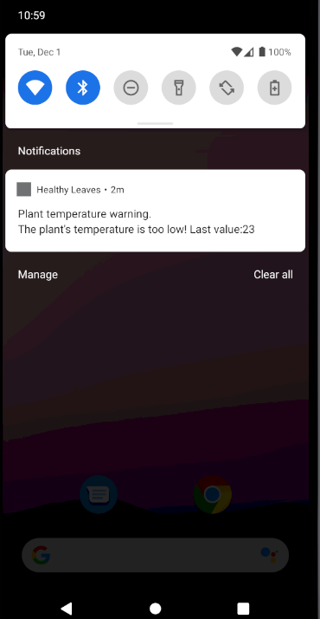

Slide 32
Data Analytics
Features:
Data logging
Data plotting

Slide 33
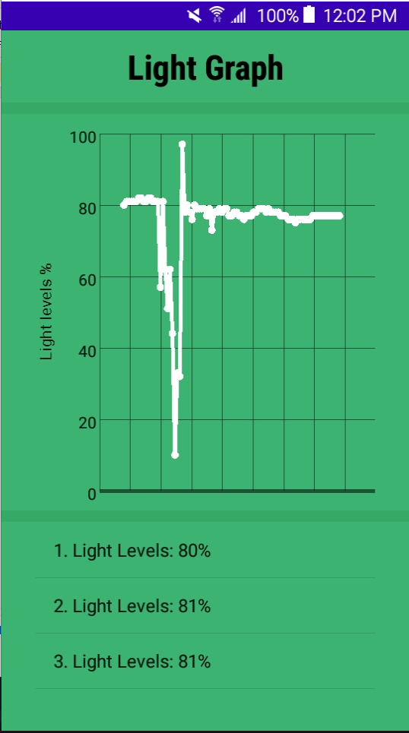
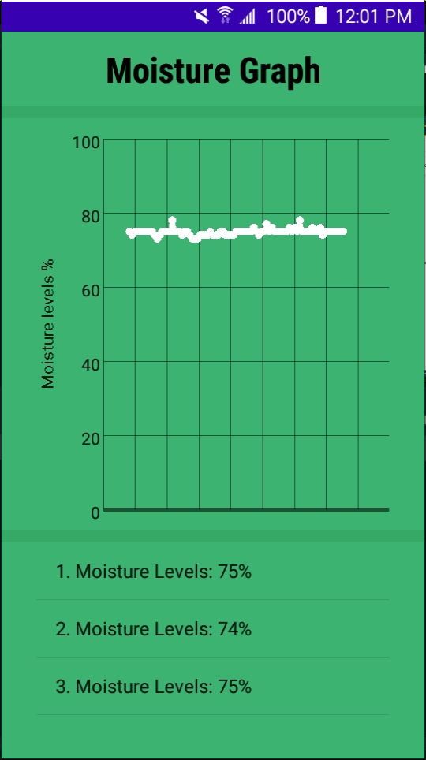
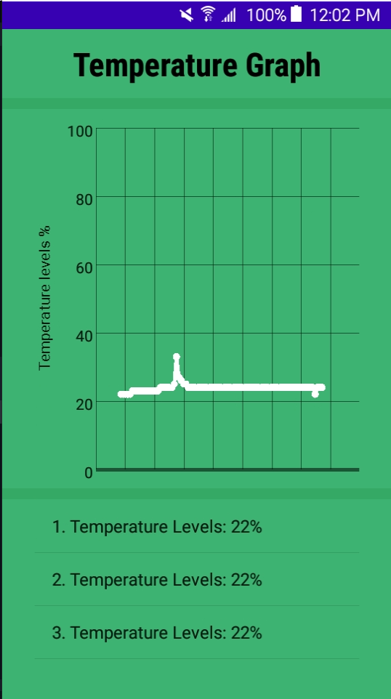

Slide 34
Advising
Features:
Analysis of real-time data versus ideal data
Text based directives based on analysis conclusion
Notes:
THOMAS:
Our application can advise its user on changes that should be made to improve the plant’s health.
In fact, it can perform an analysis of the real-time data (light, moisture and temperature) by comparing it to the ideal data stored in the large database of our catalog plants.
Our application takes user friendliness to another level by displaying TEXT based directived based on the conclusions drawn by the analysis performed.
This could be very helpful to an audience that have more difficulties using technology like my mother or even my grand-mother, to simply being able to ignore all the data and analysis; and just simply read the directives that we recommend them to take.

Slide 35
Notes:
THOMAS:

Slide 36
Plant Identification
Features:
Plant type recognition
Confidence Levels
Computational power control
Notes:
THOMAS:
A final software application feature that enhances the user experience is our application’s ability to IDENTIFY types of plants solely on image fed from the smartphone’s front camera.
This can be very useful to users that don’t have the same knowledge and expertise in the world of plants because it can be very hard to identify a plant for a casual plant owner.
Plus it can also be a fun tool when shopping for a new plant or looking at a friend’s plants to see if that plant is present in the catalog database. Which in the end is publicity for our product and will grow our client pool.
Our application can identify presently five types of plants for our users and gives the confidence levels of the classification performed, with a list of other possibilities too. (Daisies, dandelions, roses, sunflowers, and tulips, the most popular flowers we chose to complete the training and testing of our datasets. And could easily grow with more training data time).
With some android devices being less powerful than others, we also added the feature of the user being able to control the number of threads being run by the plant identifier.

Slide 37
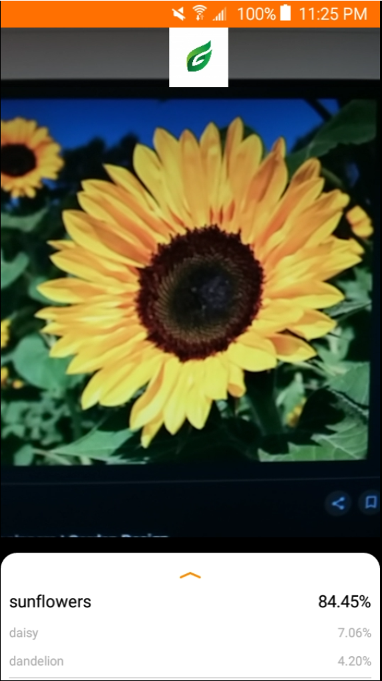
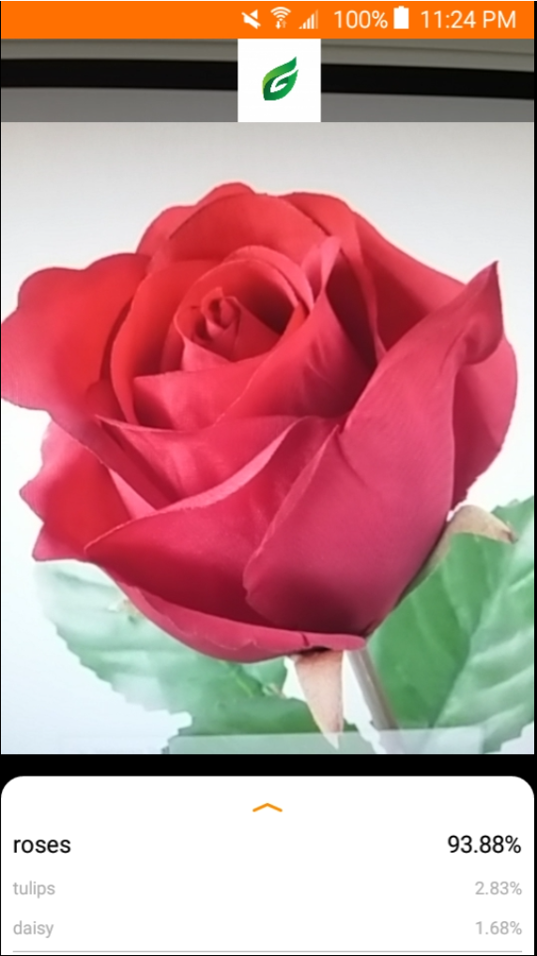
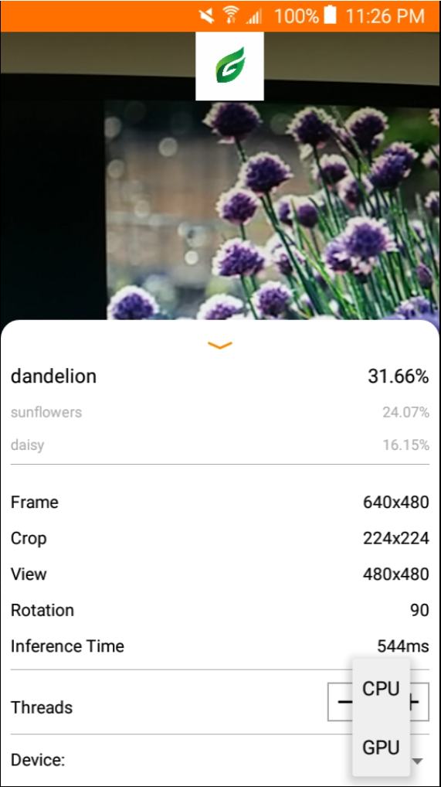
Notes:
THOMAS:

Slide 38
Hardware
How-to
Sensors
Wireless
Build
Notes:
4 sections to cover

Slide 39
How-to
Features:
USB battery charging
Insert moisture sensor in the soil and forget it
Use pairing code to link hardware to the app

Slide 40
Sensors
Currently three:
Sunlight
Soil moisture
Temperature

Slide 41
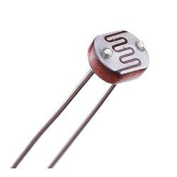
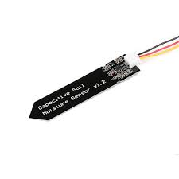
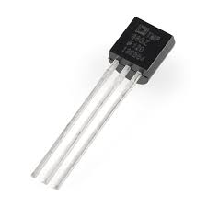
Light Sensor
Moisture Sensor
Temperature Sensor
Notes:
Cheap sensor, low profile sensors, dont take space, allows for portable design

Slide 42
Wireless
Features:
ESP-32 Chipset
WiFi 2.4GHz
Notes:
CHEAP

Slide 43
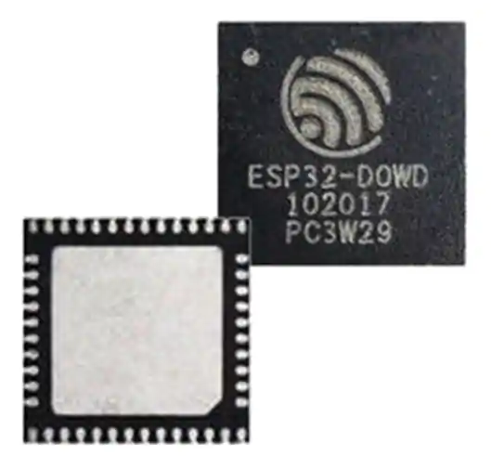
ESP-32 System on Chip
Notes:
Change picture

Slide 44
Build
Features:
HDPE
Low cost
Recyclable
Low profile

Slide 45
Future
Features to add:
QR code pairing
Big Data Analytics of Ideal Values
Self-made hardware
AI health tracking

Slide 46
THANKS!
Any questions?
You can find us at
healthyleaves.ca or
daniel@healthyleaves.ca

Slide 47
Questions?
We would love to hear your feedback!

